Slide 1


SVoice:
Enabling Voice Communication in Silence via Acoustic Sensing on Commodity Devices
Yongjian Fu

Slide 2
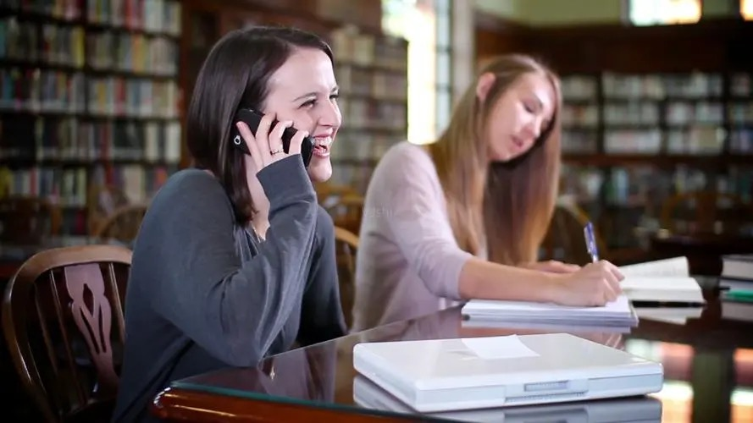
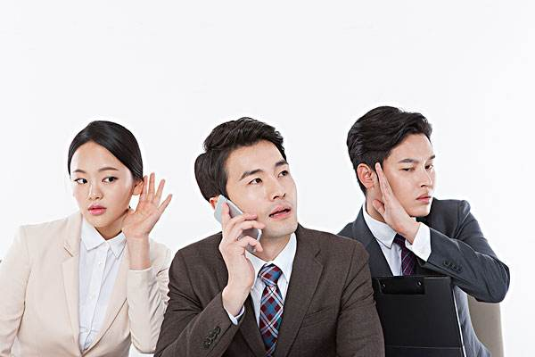
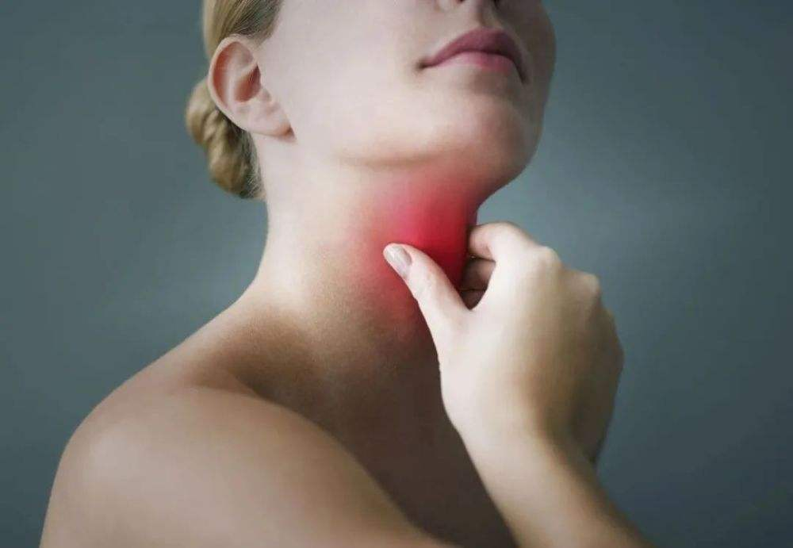
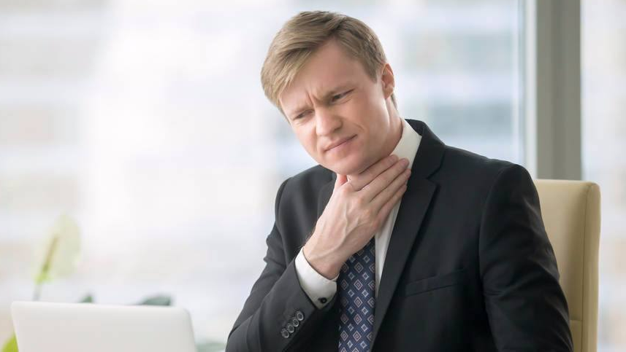
1
Background
Phone calls in public
Acquired aphasia
Notes:
首先，它可以作为现在语音通话技术的补充，让人们在公共场合下打电话的时候不用担心影响到周围的人，也不用担心对话中隐私内容被偷听到。
其次，它还可以用于一些危险场合的求救，像是夜晚的时候我们发现有陌生人潜入了家中，这种情况下直接大声呼救或者报警所发出的声音很有可能会刺激对方做出一些过激的反应，从而导致悲剧的发生。在这些情况下，无声语音接口可以让我们用一种隐蔽方式报警呼救，而不容易被察觉到。

Slide 3
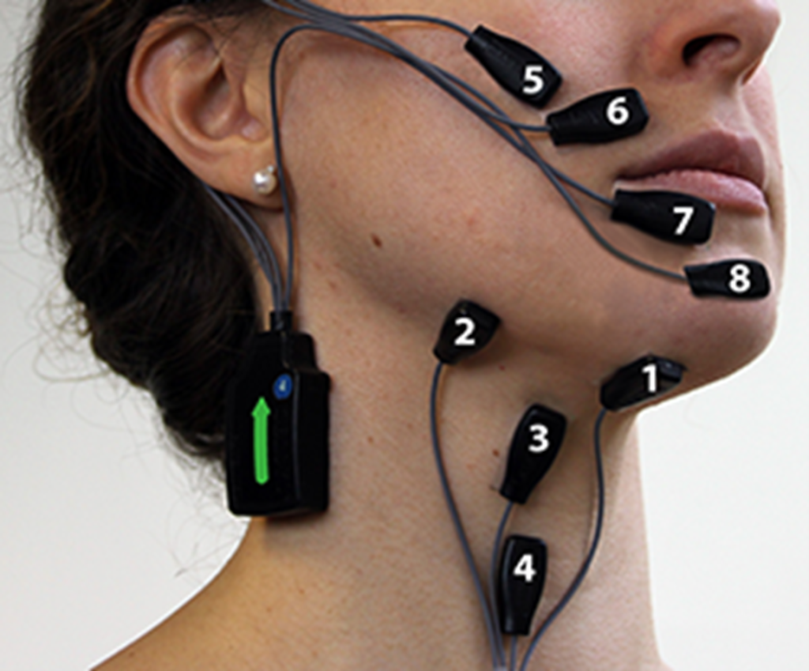
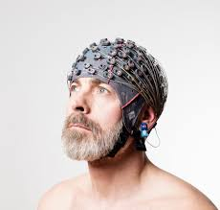


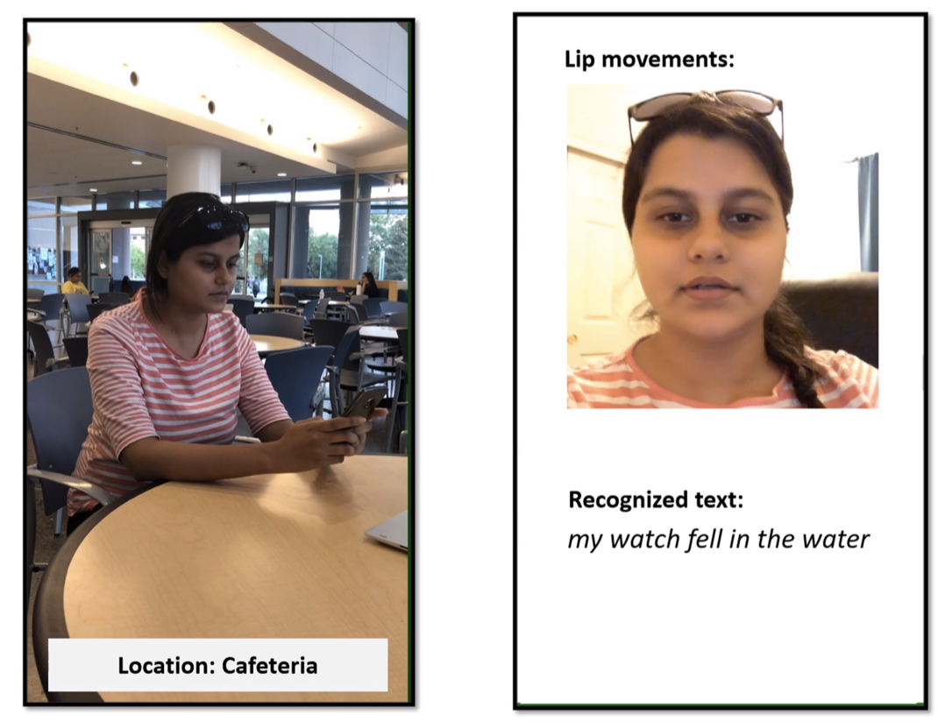

1
Background
Prolonged contact
Wearable
Anaphylactic reactions
EMG
EEG
Privacy concerns
Vision
Not robust in low light conditions
Camera

Slide 4





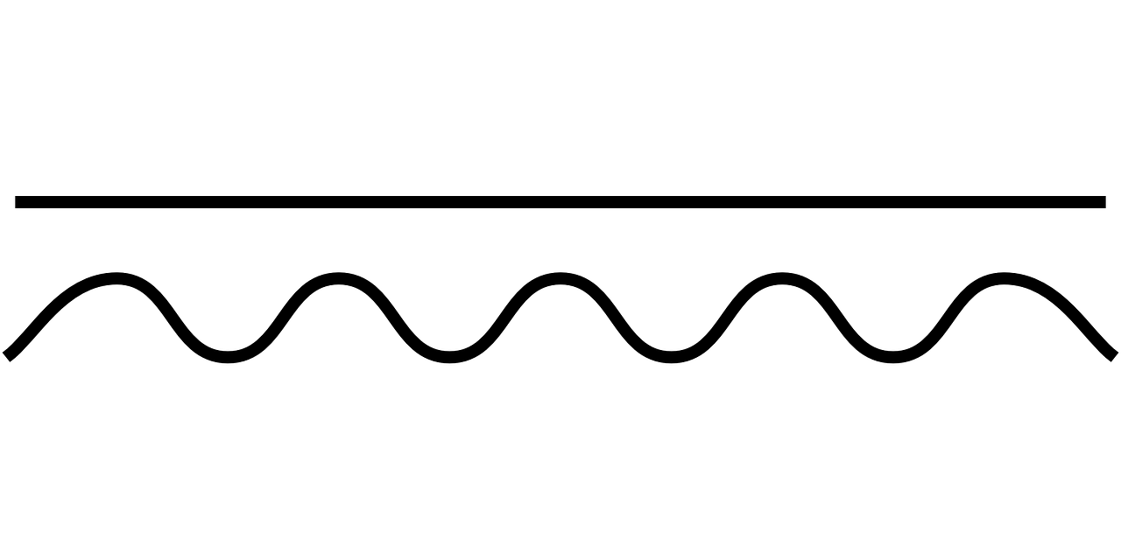


2
Basic idea of SVoice
Non-invasive
Ubiquitous
Performs well in low light conditions
Audible Audio
Ultrasonic Signal
Reflected Signal
Smartphone

Slide 5
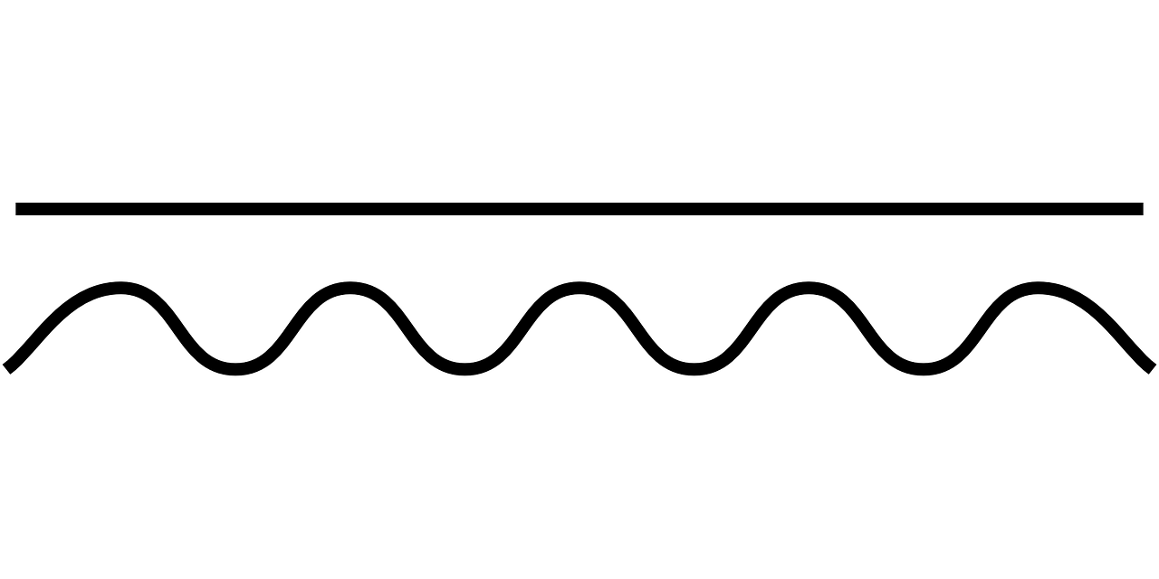
3
Sensing articulatory gestures
Reconstruction
Audible Audio
Sensing
Ultrasonic Signal
Correspondence

Slide 6

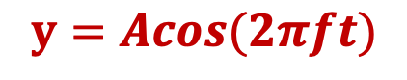
3
Sensing articulatory gestures
Speaking characteristics:
fast (-80cm/s~80cm/s) and
subtle (<5cm) movements
Signal design requires fine-grained！！
Sensing vacuum
symbol frame
Amplitude
…
(OFDM, Chirp)
cm-level
$$y=Acos(2πft)$$
Our Choice！
(Continuous wave)
mm-level
time

Slide 7






3
Sensing articulatory gestures
Coherent Demodulation
$$sin(2πft)$$
$$R\left(t\right)×sin\left(2πft\right)=A′sin\left(2πft+φ\right)×sin\left(2πft\right)$$
Lowpass
filtering
$$Q(t)$$
$=\frac{A′}{2}sin\left(4πft+φ\right)+\frac{A′}{2}sin\left(φ\right)$.
$$R(t)$$
Received
signals
Lowpass
filtering
$$I(t)$$
$$R\left(t\right)×cos\left(2πft\right)=Acos\left(2πft+φ\right)×cos\left(2πft\right)$$
$$cos(2πft)$$
$=\frac{A′}{2}cos\left(4πft+φ\right)+\frac{A′}{2}cos\left(φ\right)$.
Features：Phase and Amplitude

Slide 8



3
Sensing articulatory gestures
$$Gradient=R\left(t\right)−R(t−1)$$
Rad-Grad
Rad
distance error
Inaudible frequency band (17k-22kHz)
time
$$Δf=700Hz$$
Phase Variation Induced by Mouth Opening
$$y=\sum_{i}^{8}{Acos({2πf}_{i}t)}$$

Slide 9
4
Reconstruct audio from ultrasound
Ultrasonic Signal
Reconstruction
Audible Audio
Sensing
Correspondence

Slide 10


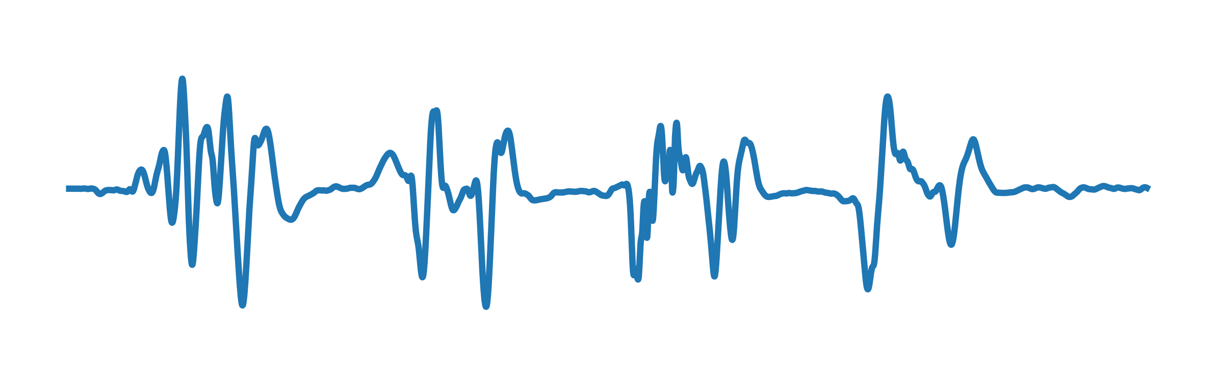
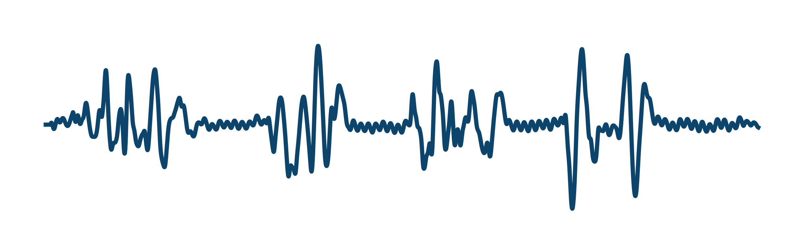
4
Reconstruct audio from ultrasound
Audio
“A”
“C”
Comparison of signal characteristics of audio and ultrasonic
0.5
Amplitude
0
Audio signals | Ultrasonic signals
High-dimensional | Low-dimensional
Information-rich | Information-poor
-0.5
“B”
“D”
1
2
3
4
5
Time (sec)
Audio signal in the time domain when saying "ABCD".
Phase gradients
Amplitude gradients
What is he saying?
“A”
“C”
0.5
Amp/Pha Grad
0
-0.5
“B”
“D”
Rich contextual information！！
1
2
3
4
5
Time (sec)
Variation of the phase amplitude gradient when saying "ABCD".

Slide 11
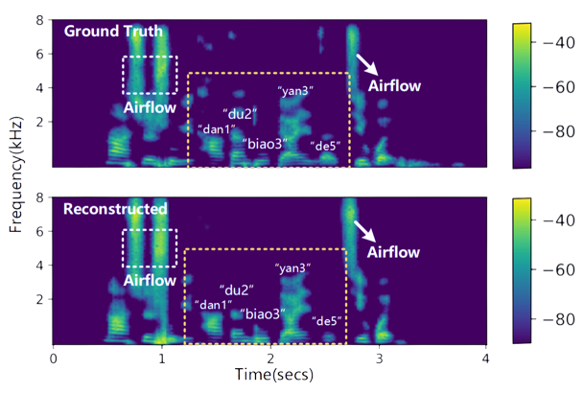
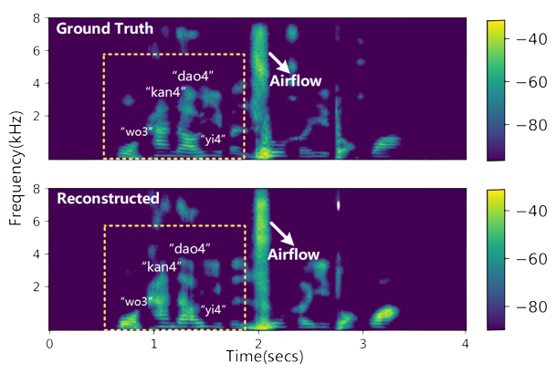
4
Reconstruct audio from ultrasound
frequency
frequency
CNN
…
…
time dimension
time
time
8 channels
phase gradients
Phase
features
Mel-scale Frequency
Cepstral Coefficients
(MFCCs)
The reconstructed T-F spectrum
Vocoder
Audible Audio
CNN
Transformer
…
time dimension
Feature embedding
Intermediate
Final
CNN
…
…
8 channels
amplitude gradients
time dimension
We can now reconstruct the audio from the ultrasound ！！
Amplitude
features

Slide 12
5
Capture correspondence
Ultrasonic Signal
Reconstruction
Audible Audio
Sensing
Correspondence

Slide 13
5
Capture correspondence
Overlapping
Naïve solutions: A dataset rich in various sentences
High data collection overhead！
Data pairs:（Ultrasound, Audio）
Easy to collect
“A”
“B”
Back-translation!
（cn, en）
CN
EN
EN
CN
Overlapping
“A”
“C”
wild en
cn
（en, cn）
new data

Slide 14
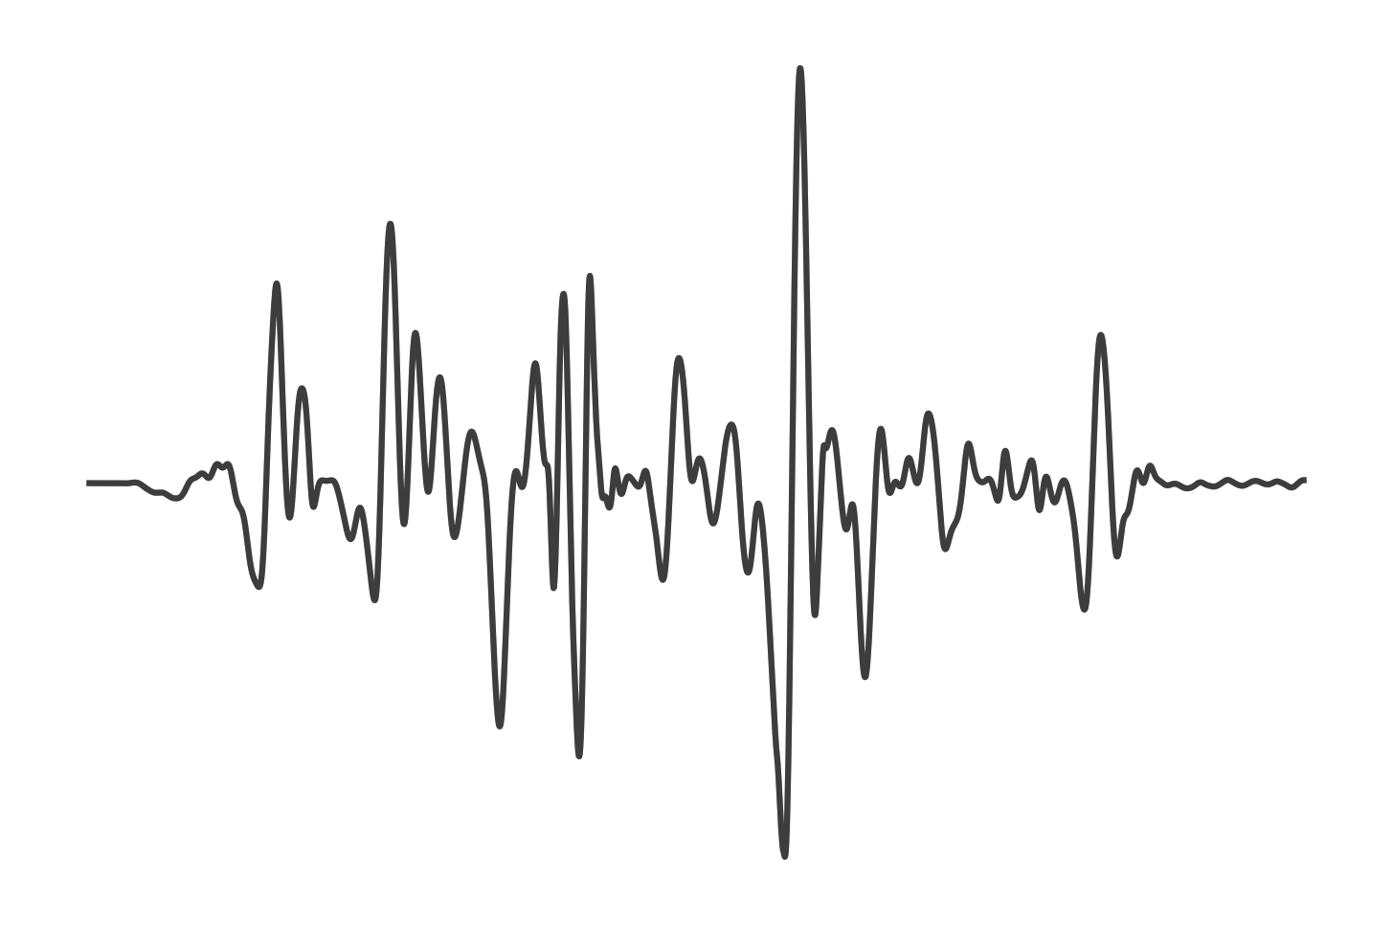
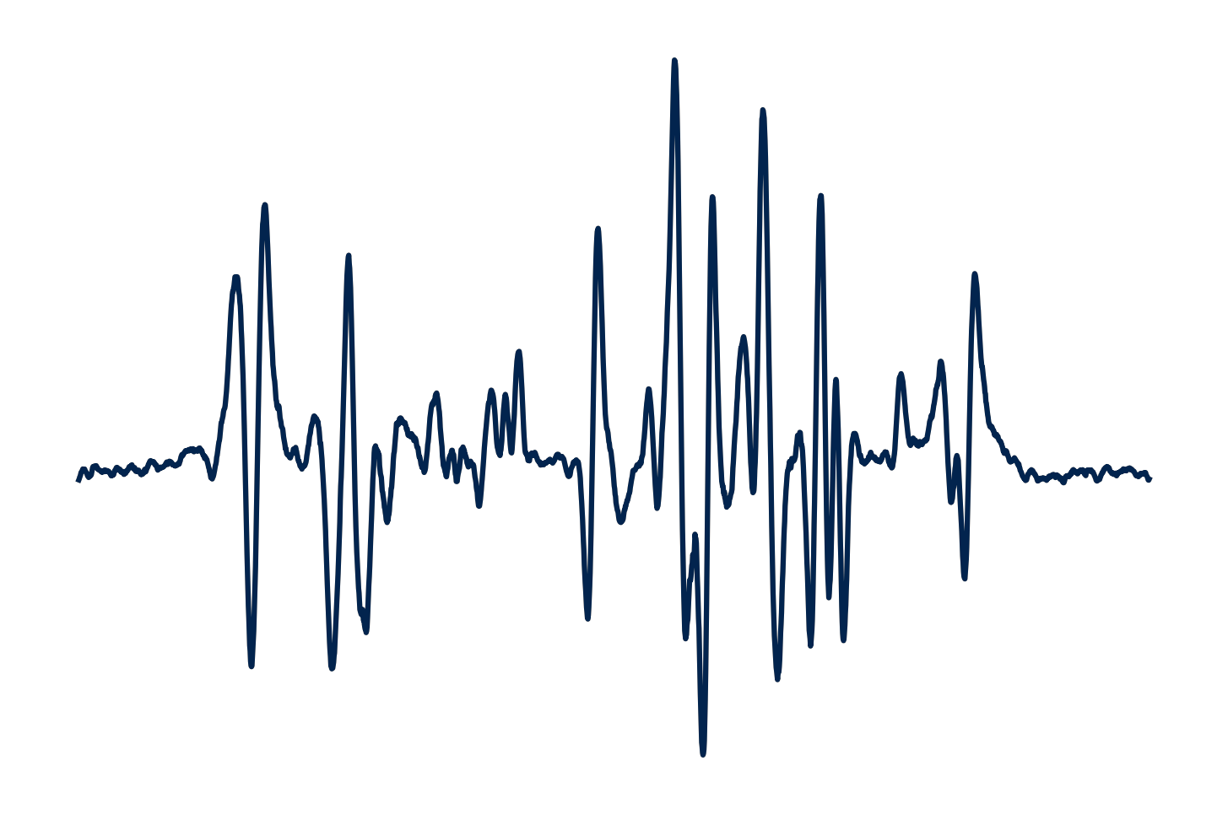
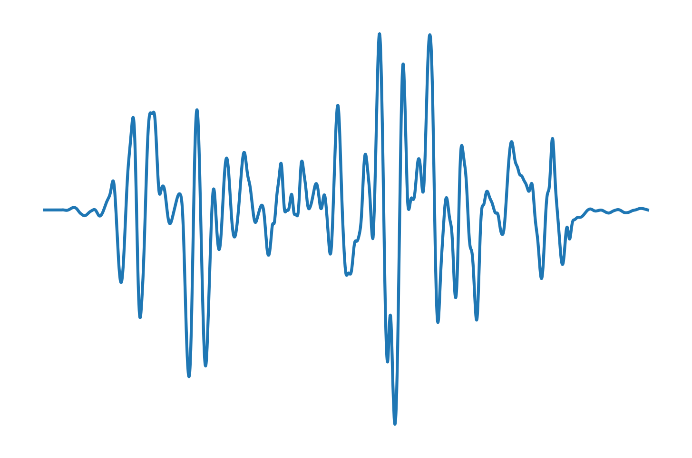
5
Capture correspondence
audio
noise
Wild audio
Virtual Gestures
Generator
Ground truth
Back translation
Our approach
0.5
Gradients
0
Anchor
Negative
Positive（label）
-0.5
1
2
3
4
5
Time (sec)
Discriminator
The generated virtual gesture signal corresponding to a wild audio
Real or Fake?

Slide 15
6
User adaptation
Ultrasonic Signal
Reconstruction
Audible Audio
Sensing
Correspondence

Slide 16






6
User adaptation
fine-tuning
user A
ultrasound
audio
Feature extractor
user B
ultrasound
audio
amp
time
user C
ultrasound
audio
grad
Time-domain unaligned！！
time

Slide 17





6
User adaptation
$$ℒ={∥A}_{label}−A_{predict}∥_{2}$$
ultrasound
prediction
$$ℒ={∥A}_{label}−A_{predict}∥_{2}+ℒ_{time}$$
supervise
mapping
best label
Pseudo label
best mapping
session 1
session 2
session 3
Data pairs in different sessions from one user
best matching
Dynamic Timing Warping (DTW) Algorithm
ultrasound from new user

Slide 18
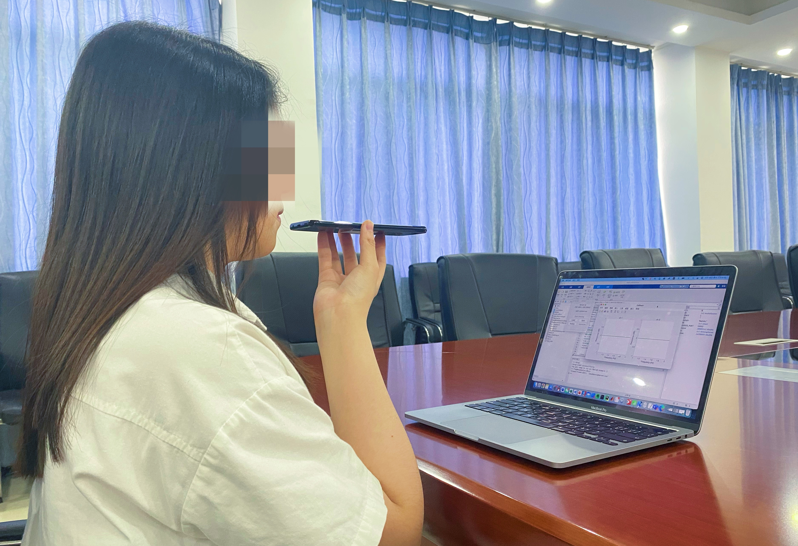

7
Experimental setup
Dataset: including ten subjects, 3 environments, 250 sentences.
Smartphone
Server PC
Mainly metrics :
$CER=\frac{\text{Ins}\text{+}\text{sub}\text{+}\text{Del}}{\text{Ref}}$.
Experimental setup

Slide 19
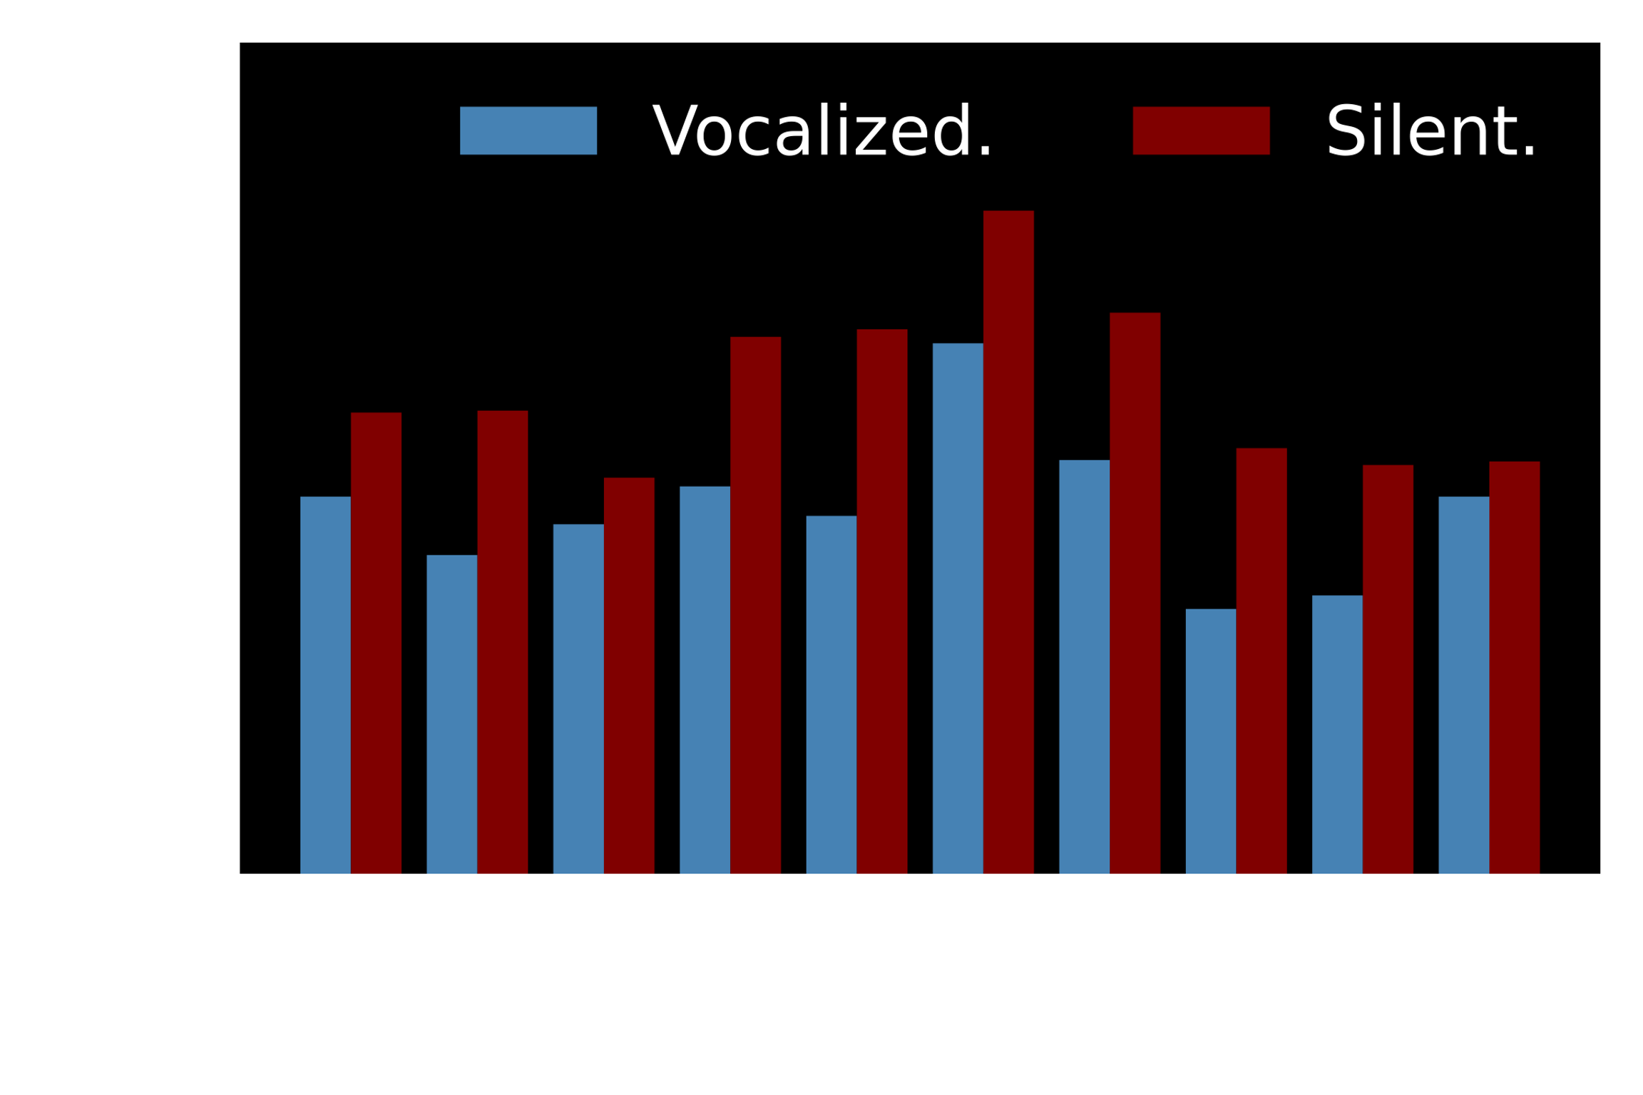
8
Evaluation: overall performance
Comparison with Baseline Methods
Method | CER
Lip2Wav (Vision-based) | 14.08%
SoundLip (Acoustic-based) | 12.56%
SVoice (ours) | 5.72%
Performance of each subject during vocalization/silence.

Slide 20
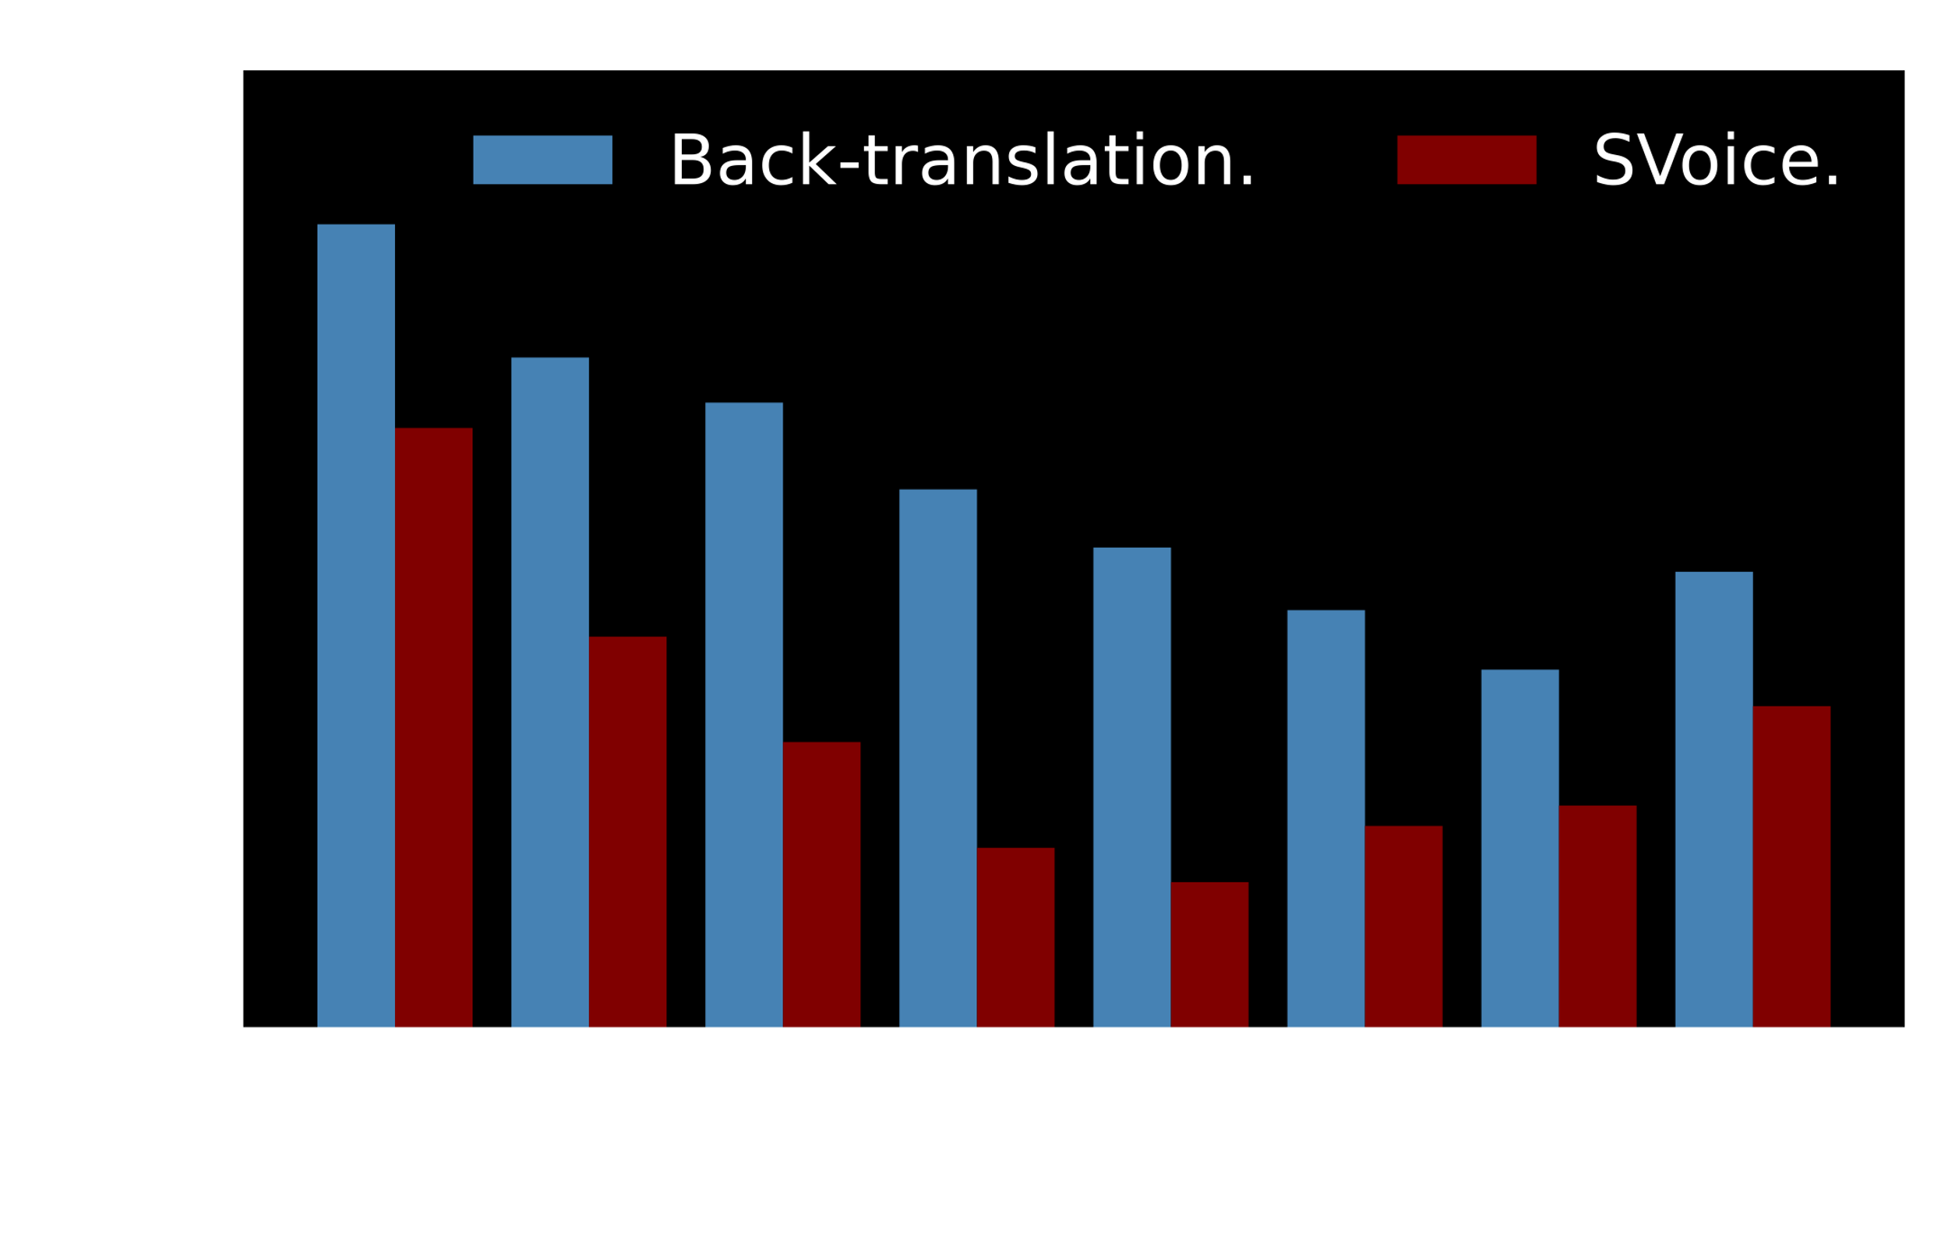
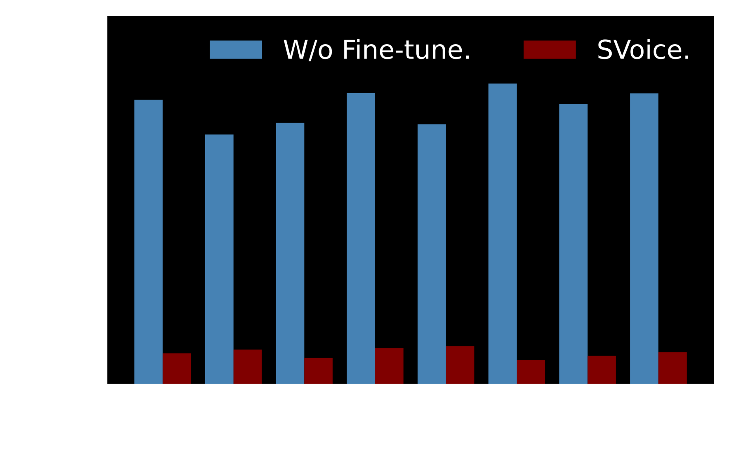
8
Evaluation: virtual gestures and user adaptation
The best
Performance of virtual gesture generation.
Performance of diverse targets is basically stable.

Slide 21
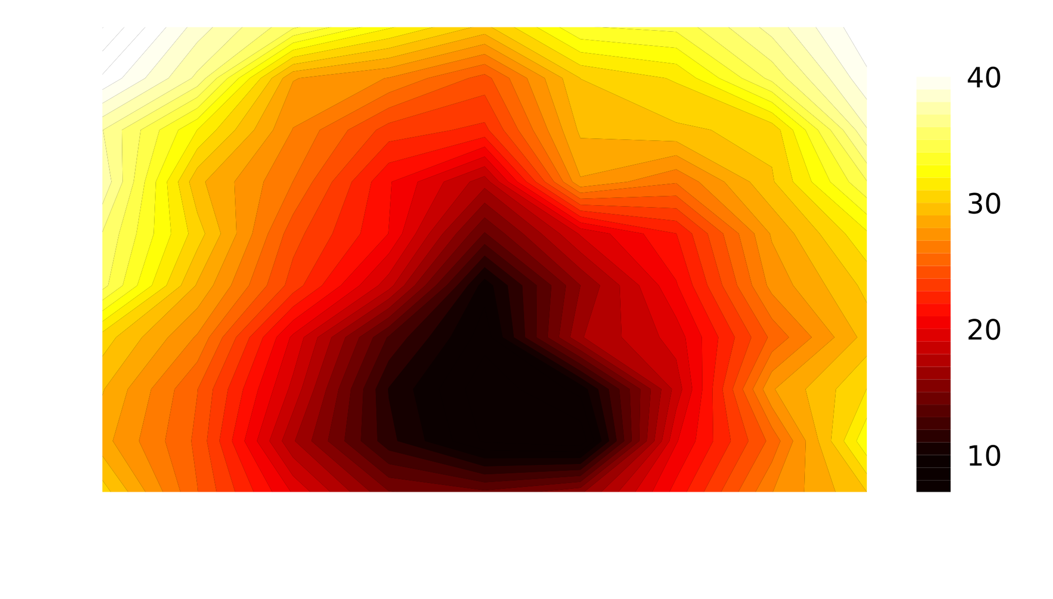
8
Evaluation: distance and orientation
40
-20°～20°
30
1～6cm
Sensing area
20
10
The effect of distance and orientation of the device

Slide 22
9
Limitation and future work
Sensing in body motion
Device portability
Continuous and real-time inference

Slide 23
Conclusion
1
SVoice designs an end-to-end Silent Speech Interface that reconstructs audible speech using ultrasound signals reflected by articulatory gestures in silence.
2
SVoice presents design a cross-modal data augmentation mechanism that can generate virtual articulatory gestures from wild audio.
3
Svoice proposes a user adaptation technique that utilizes a small amount of unlabeled ultrasound data to fine-tune the model for different users.

Slide 24
THANK YOU
Email: fuyongjian@csu.edu.cn

